Slide 1
How to Train your dragon
Training VISION mODEL for MONOCULAR Depth estimation and MASK generation

Slide 2
DATASET IS THE BEAST
1.2 Million images,
Uncompressed size = ~20GB
Time to Extract Entire Dataset = “Forever” (~15 m to 2h on Colab)
Data Management is a major challenge. Following options were considered:
Option | Observations
Bulk load all data | Easy access. Highly unreliable during extraction and long preload time
Create HDF5 dataset | Awesome r/w speeds. Diskspace even with compression ~10x
GCS Buckets | Easy access r/w speeds. High latency ~2.4ms
Torch dataloaders with Zip | Decent r/w speeds and per-epoch speeds. Unreliable as training proceeds due to parallel access.
Torch dataloaders with selective preload | Much better r/w speeds and per-epoch speeds. Preload time limited to the chunk getting loaded.
Data Sources Profiling link

Slide 3
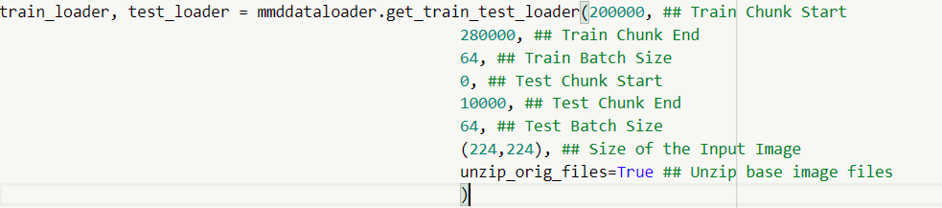


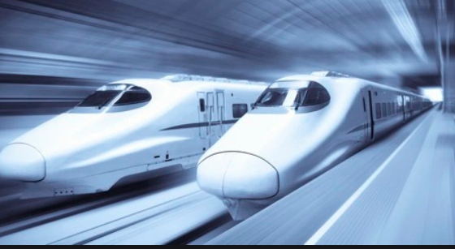
Data PIPELINE
Data Loaders Link:
Preloader Functions
Train Dataset
Train.csv
Gdrive Filestore
Train Loop
Test Dataset
Test.csv

Slide 4
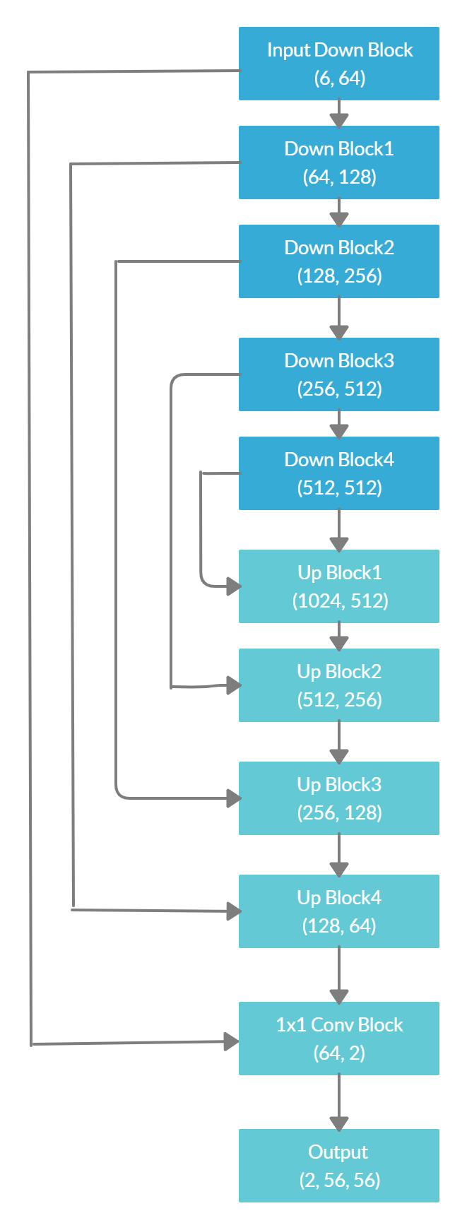
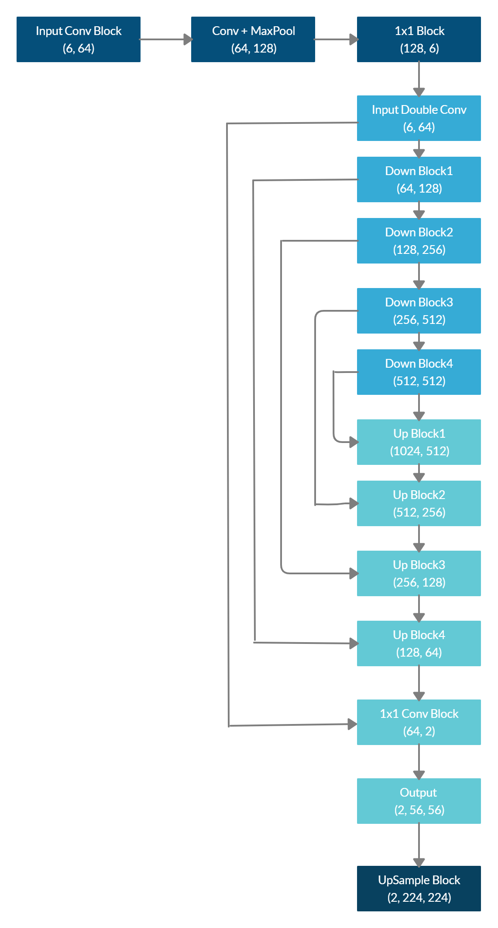
DNN Models
Model | Parameter Count | Link
Modified Unet-224 | Total params: 17,532,622 Trainable params: 17,532,622 Non-trainable params: 0 Input size (MB): 1.15 Forward pass size (MB): 324.75 Params size (MB): 66.88 Estimated Total Size (MB): 392.78 | Base Model Link Final Model Link
The final model consists of two parts:
Base Unet-56: Base U-Net styled model with
Input_size of (6, 56, 56) and
outputs (2, 56, 56)
Param Count: ~17.3 M
Double Conv Layer + Base Unet-56 + UpSampling layer:
Input_size of (6, 224, 224) and
Output Size (2, 224, 224)
Param Count: ~17.6M

Slide 5
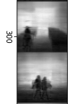
DNN Models – OTHER ModelS EVALUATED
Model | Parameter Count | Challenges/Observations | Link
Plain Resnet50 with last layers modified to (2, 224, 224) | Total params: 20,132,864 Trainable params: 20,132,864 Non-trainable params: 0 Input size (MB): 1.15 Forward pass size (MB): 2751.66 Params size (MB): 76.80 Estimated Total Size (MB): 2829.61 | Checkerboard/Vertical Strides observed. | MonoMaskDepthResnet
Resnet-18 + Unet | Total params: 28,476,354 Trainable params: 28,476,354 Non-trainable params: 0 Input size (MB): 1.15 Forward pass size (MB): 2751.66 Params size (MB): 76.80 Estimated Total Size (MB): 2829.61 | Long convergence time and difficult to train larger batch size. | ResnetUnet

Slide 6
Training Strategy
Main Notebook Link(For Stg2 and Stg3):
https://github.com/rajy4683/S15FinalSubmission/blob/master/S15EVA4_FinalOutput.ipynb
Training Stage-1: Sample
https://github.com/rajy4683/S15FinalSubmission/blob/master/S15Unet6_Large_56.ipynb
Training Stage-1
(Strengthen Spine)
Use BaseModel
56x56 Image Size
Large Batch Size
Cover Full Dataset in chunks of 50K
Target decent performance.
Training Stage-2
(Add head and tail, train only head and tail)
Head and tail added to Baselined Model from Stage-1
Freeze all Spine Layers
Image Size (224x224)
Medium Batch Size(64)
Cover Full Dataset in chunks of 50K
Training Stage-3
(Full-Scale Training)
Unfreeze all layers and perform necessary tuning
Train full Image Size
Cover Full Dataset in chunks of 100K

Slide 7
Training Strategy
Adopt multi-task learning strategy(i.e train for both Masks and Depth Prediction) from the beginning (mainly inspired from EIP4 and HyperFace).
Randomly sample full training dataset and create chunks of 50K. Each chunk had a decent combination of various fg/bg combinations. Classes of BG were: (classrooms, college_outdoors, corridors, dining_room, lobby, malls, meeting_rooms)
Training Stage-1 (Strengthen Spine)
For training each chunk:
Base Unet model with input_size (6,56,56) was used (fg_bg images and plain bg images were concatenated)
Initial iterations used simple loss functions(RMSE) and basic augmentations like Horizontal Flip.
Large batch size of up to 256 (on P100 whenever available)
Checkpoint major improvements and retrain from the previous checkpoint.
Evaluated Multiple Loss Functions and finalized on
Training Stage-2 (Add Head and Tail)
Add Double-Conv Layer to accept (6, 224, 224) as the input and UpSample output from previous stage to 4x
Repeat Training Loop over in chunks
Training Stage-3 (Unfreeze all layers)
Tune hyperparameters and repeat Training Loop over in chunks

Slide 8
LOSS FUNCTIONS
Loss Functions Evaluated | Task | Observation
RMSE | Depth Prediction and Mask Formation | Very helpful in mask prediction tasks. Acts as a good regularizer when used with other loss functions
L1 Loss | Depth Prediction and Mask Formation | Provides better convergence than RMSE/L2. Acts as a good regularizer when used with other loss functions
BCELossWithLogits | Mask Formation | Resulted in noisy output on multiple datasets
Dice Loss | Mask Formation | For masks, feature formation was much faster with Dice Loss
SSIM Loss | Depth Prediction | Quite reliable and provides faster feature formation
Pixel Weighted L1/L2 Loss | Mask Formation | Intention was to use it with other loss functions to regularize but seems to cause large noise over images.
Final Loss Function used:
For Mask Prediction:
L1Loss + Dice Loss
For Depth Estimation:
RMSE Loss + SSIM Loss
Losses Module Link:
Results of various loss functions are present in this link

Slide 9
Profiling results
ncalls | tottime | percall | cumtime | percall | TimePercent | filename:lineno(function)
1 | 0.036 | 0.036 | 181.691 | 181.691 | 100% | mmdtraintest.py:216(execute_model)
2 | 0.128 | 0.064 | 177.648 | 88.824 | 98% | mmdtraintest.py:114(train_batch)
644 | 0.194 | 0 | 45.075 | 0.07 | 25% | mmdlosses.py:20(construct_criterion)
322 | 0.002 | 0 | 44.001 | 0.137 | 24% | mmdlosses.py:59(LocalSSIMLoss)
322 | 0.275 | 0.001 | 43.755 | 0.136 | 24% | ssim.py:82(forward)
322 | 0.013 | 0 | 6.239 | 0.019 | 3% | mmdmodels.py:169(forward)
5152/3542 | 0.08 | 0 | 4.966 | 0.001 | 3% | container.py:98(forward)
3542 | 0.014 | 0 | 4.697 | 0.001 | 3% | mmdmodels.py:30(forward)
322 | 0.015 | 0 | 4.562 | 0.014 | 3% | mmdmodels.py:105(forward)
314 | 0.003 | 0 | 3.915 | 0.012 | 2% | tensor.py:170(backward)
314 | 0.003 | 0 | 3.912 | 0.012 | 2% | __init__.py:45(backward)
314 | 3.892 | 0.012 | 3.892 | 0.012 | 2% | {method 'run_backward' of 'torch._C._EngineBase' objects}
2 | 0.001 | 0.001 | 3.561 | 1.78 | 2% | mmdtraintest.py:172(test_batch)
1288 | 0.041 | 0 | 2.347 | 0.002 | 1% | mmdmodels.py:63(forward)
1610 | 0.005 | 0 | 2.334 | 0.001 | 1% | mmdmodels.py:44(forward)
7728 | 0.025 | 0 | 2.087 | 0 | 1% | conv.py:348(forward)
7728 | 0.039 | 0 | 2.048 | 0 | 1% | conv.py:340(_conv_forward)
7406 | 0.642 | 0 | 2.011 | 0 | 1% | batchnorm.py:83(forward)
7084 | 0.014 | 0 | 0.433 | 0 | 0% | activation.py:93(forward)
322 | 0.003 | 0 | 0.353 | 0.001 | 0% | mmdlosses.py:35(LocalFocalLoss)
1610 | 0.007 | 0 | 0.342 | 0 | 0% | upsampling.py:130(forward)
322 | 0.191 | 0.001 | 0.328 | 0.001 | 0% | mmdlosses.py:80(forward)
1932 | 0.008 | 0 | 0.278 | 0 | 0% | pooling.py:138(forward)
322 | 0.101 | 0 | 0.218 | 0.001 | 0% | mmdlosses.py:63(dice_loss)
322 | 0.022 | 0 | 0.109 | 0 | 0% | mmdlosses.py:38(LocalPixelLoss)
322 | 0.003 | 0 | 0.104 | 0 | 0% | mmdlosses.py:50(LocalRMSELoss)
322 | 0.003 | 0 | 0.094 | 0 | 0% | mmdlosses.py:47(LocalL1Loss)
644 | 0.002 | 0 | 0.091 | 0 | 0% | loss.py:431(forward)
322 | 0.001 | 0 | 0.087 | 0 | 0% | mmdmodels.py:83(forward)
322 | 0.001 | 0 | 0.064 | 0 | 0% | loss.py:87(forward)
322 | 0.001 | 0 | 0.017 | 0 | 0% | mmdlosses.py:76(__init__)
16 | 0 | 0 | 0.001 | 0 | 0% | mmddataloader.py:272(__len__)
For profiling runs, cProfile python module was used for training loops
Two striking observations:
SSIM Loss takes a whopping 56ms per call, around 20% of run-time
Any .item() call causes CUDA synchronization which consumes ~171ms
Dataloaders take nearly 3-8% of total time and most of the time is spent in thread lock
Further details can be found here:
https://github.com/rajy4683/S15FinalSubmission/blob/master/Profiling.xlsx
Profiling Notebook

Slide 10
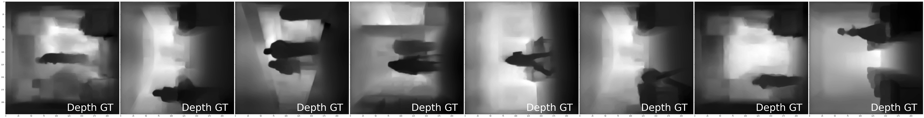
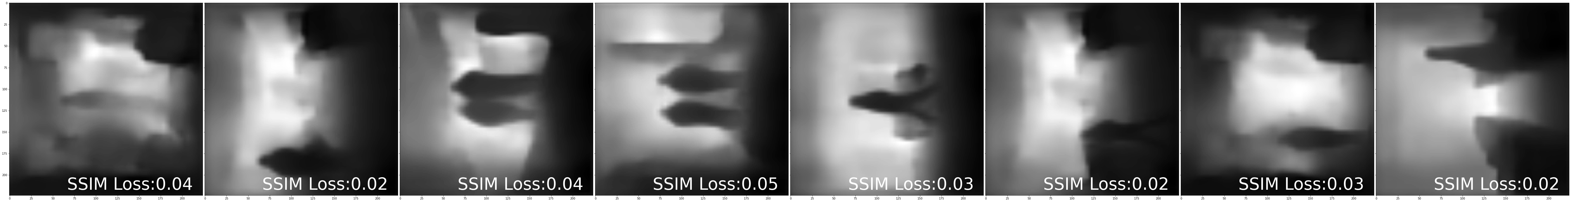
FINAL results
Losses | Values
Overall Loss | 0.94152086
Overall Mask | 0.87551310
Overall Depth Loss | 0.06600758

Slide 11
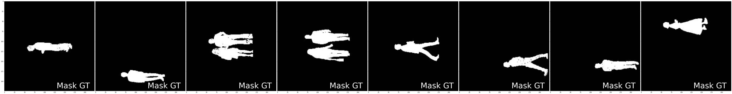
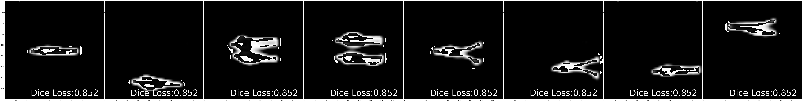
FINAL results
Losses | Values
Overall Loss | 0.94152086
Overall Mask | 0.87551310
Overall Depth Loss | 0.06600758

Slide 12
Handling COLAB
One central Google Drive was created which contains:
Base Modules
Raw Image Zip files
Model Checkpoint directories
Logs and other useful files
Multiple Google accounts were linked back to the shared Google Drive.
All notebooks, upon Colab expiry were pushed into private GitHub repository and reloaded directly from GitHub to allow for easy resuming of training

Slide 13
Reference CITATIONS CREDITS
Main model was inspired from this code:
https://github.com/milesial/Pytorch-UNet
Papers that really helped to understand Monocular depth estimation:
UnsupervisedMonocular Depth Estimation with Left-Right Consistency.
Unsupervised CNN for Single View Depth Estimation: Geometry to the Rescue
Depth Map Prediction from a Single Image using a Multi-Scale Deep Network
Original U-Net paper: U-Net: Convolutional Networks for Biomedical Image Segmentation
https://lars76.github.io/neural-networks/object-detection/losses-for-segmentation/ (Awesome details on variety of loss functions)
EVA4 community discussions and of course Rohan Shravan for all the mentoring.

